Slide 1
Classification:
Learning from Neighbors
C5483 Data Warehousing and Data Mining

Slide 2



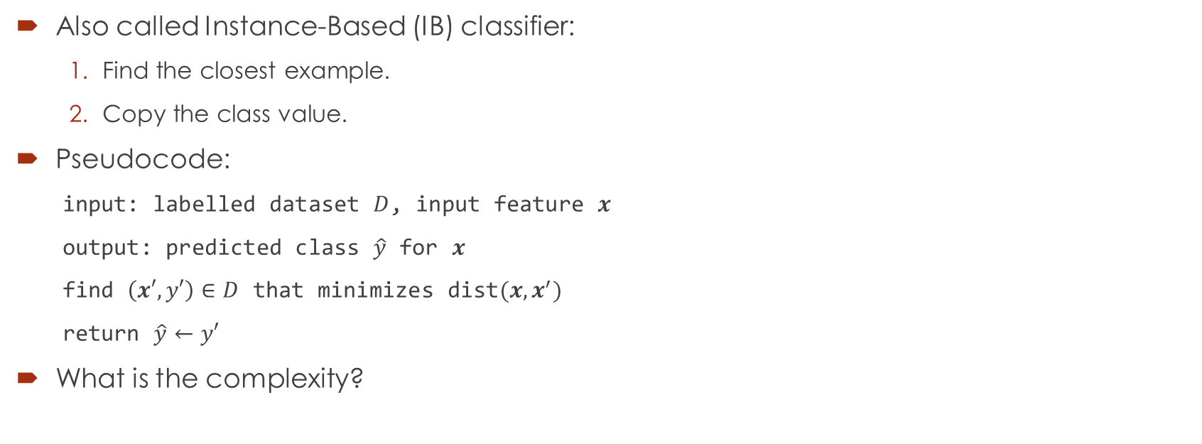




Nearest Neighbor (NN) classifier
$$D$$
$X_{1}$ $X_{2}$ $Y$
1. 0 0 0
2. 0 1 0
3. 1 0 0
4. 1 1 1
Also called Instance-Based (IB) classifier:
  Find the closest example.
  Copy the class value.
Pseudocode:
  input: labelled dataset $D$, input feature $x$
  output: predicted class $\hat{y}$ for $x$
  find $\left(x′,y′\right)∈D$ that minimizes $\text{dist}(x,x^{′})$
  return $\hat{y}←y′$
What is the complexity?
$$X_{2}$$
1
$$\left(x′,y′\right)=(1,1,1)$$
0
1
?
$$x=(0.75,0.75)$$
$$\hat{y}=1$$
0
0
$$X_{1}$$
0
1

Slide 3
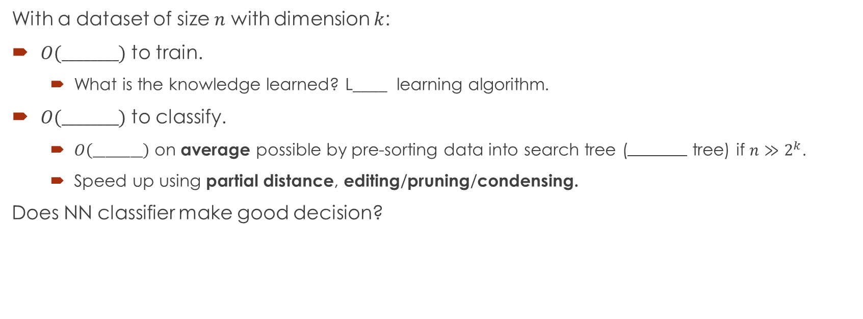
Nearest neighbor (NN) classifier
With a dataset of size $n$ with dimension $k$:
$O(________)$ to train.
  What is the knowledge learned? L____ learning algorithm.
$O(________)$ to classify.
  $O\left(________\right)$ on average possible by pre-sorting data into search tree ( tree) if $n≫2^{k}$.
  Speed up using partial distance, editing/pruning/condensing.
Does NN classifier make good decision?

Slide 4
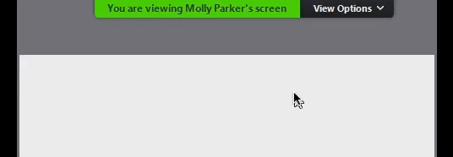




Decision regions and boundaries
Decision boundaries separate regions with different decisions (decision r________).
What are the decision boundaries for a NN classifier?
The decision boundaries for NN classifier can be obtained from V__________ diagram.
$$X_{2}$$
decision boundary
Ex:
$$X_{2}$$
1
0
1
1
0
1
0
0
$$X_{1}$$
0
$$X_{1}$$
0
0
1
1

Slide 5
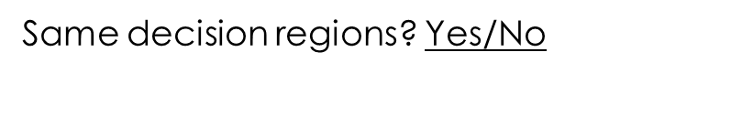




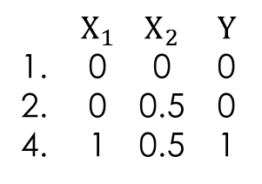
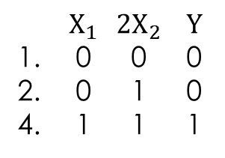
NN without normalization
Consider predicting weight using height and age. Will the decision regions/boundaries depend on the unit, e.g., cm vs m?
$$X_{2}$$
$$2X_{2}$$
1
1
0
1
$X_{1}$ $X_{2}$ $Y$
1. 0 0 0
2. 0 0.5 0
4. 1 0.5 1
$X_{1}$ $2X_{2}$ $Y$
1. 0 0 0
2. 0 1 0
4. 1 1 1
0
1
0
$$X_{1}$$
0
$$X_{1}$$
0
0
1
1
Same decision regions? Yes/No
Hint: Check the classification for $(0.75,0).$

Slide 6









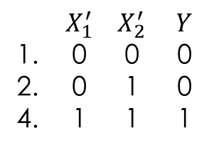

Min-max normalization
$$z_{i}^{′}≔$$
$$z_{i}∈\left[\min_{j}{z_{j}},\max_{j}{z_{j}}\right]↦\frac{z_{i}−\min_{j}{z_{j}}}{\max_{j}{z_{j}}−\min_{j}{z_{j}}}∈[0,1]$$
$$X_{2}$$
$$X_{2}$$
1
0.5
0
1
$X_{1}$ $X_{2}$ $Y$
1. 0 0 0
2. 0 0.5 0
4. 1 0.5 1
0.5
0
1
$$\max_{j}{x_{2j}}$$
0
$$X_{1}$$
0
$$X_{1}$$
0
$$\min_{j}{x_{2j}}$$
0
1
1
$$\min_{j}{x_{1j}}$$
$$\max_{j}{x_{1j}}$$
$$X_{2}^{′}$$
1
0
1
$X_{1}^{′}$ $X_{2}^{′}$ $Y$
1. 0 0 0
2. 0 1 0
4. 1 1 1
0
$$X_{1}^{′}$$
0
1

Slide 7
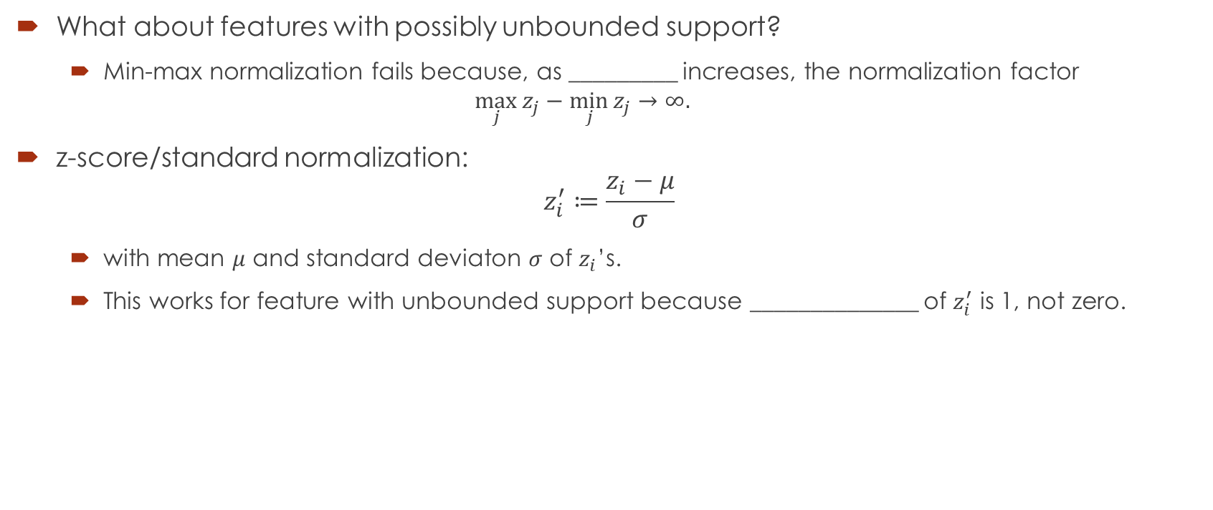
Standard normalization
What about features with possibly unbounded support?
  Min-max normalization fails because, as _________ increases, the normalization factor
  $\max_{j}{z_{j}}−\min_{j}{z_{j}}→∞.$
z-score/standard normalization:
$z_{i}^{′}≔\frac{z_{i}−μ}{σ}$
  with mean $μ$ and standard deviaton $σ$ of $z_{i}$’s.
  This works for feature with unbounded support because ______________ of $z_{i}^{′}$ is 1, not zero.

Slide 8
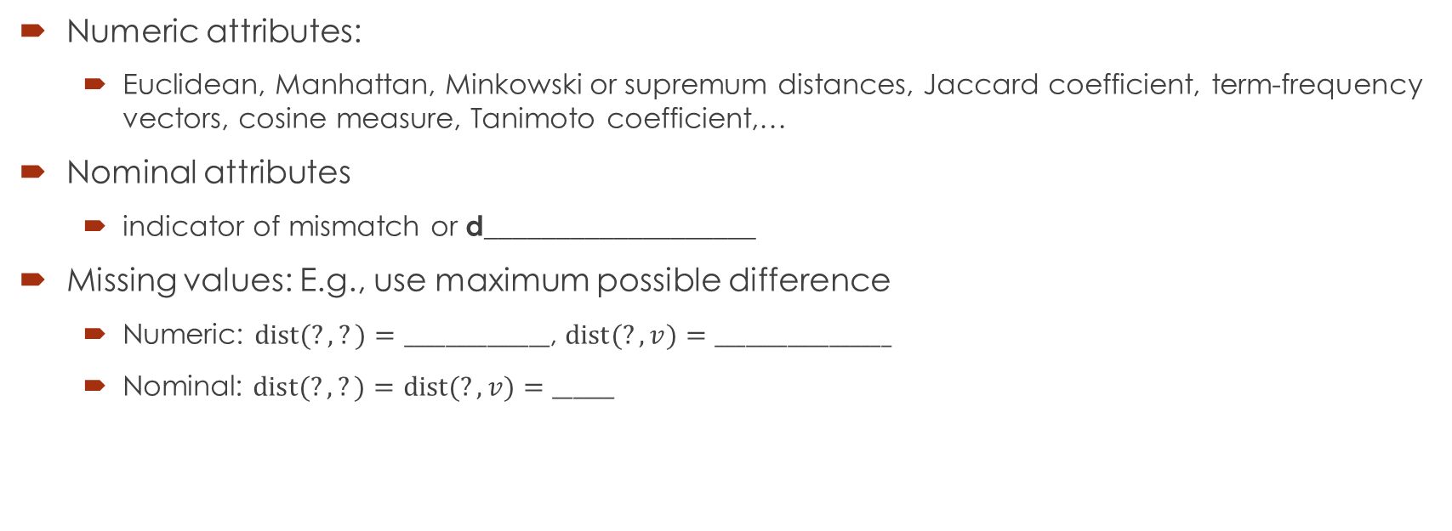
Measure of distance/similarity
Numeric attributes:
  Euclidean, Manhattan, Minkowski or supremum distances, Jaccard coefficient, term-frequency vectors, cosine measure, Tanimoto coefficient,…
Nominal attributes
  indicator of mismatch or d___________________
Missing values: E.g., use maximum possible difference
  Numeric: $\text{dist}(?,?)=______________$, $\text{dist}(?,v)=_________________$
  Nominal: $\text{dist}(?,?)=\text{dist}(?,v)=______$

Slide 9
Pros and Cons of NN classification
Can learn without too many examples. (True/False)
Can avoid overfitting. (True/False)

Slide 10


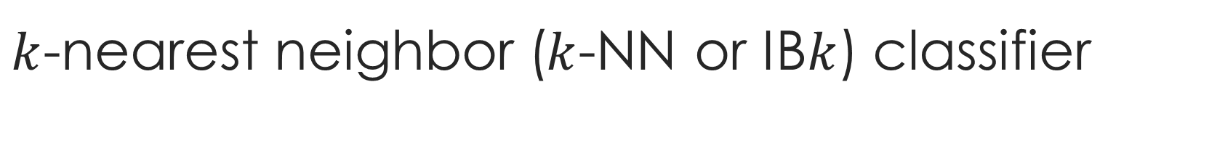






$k$-nearest neighbor ($k$-NN or IB$k$) classifier
input: Labelled dataset $D$, input feature $x$, positive integer $k$.
output: predicted class $\hat{y}$ for $x$
find $k$ nearest neighbors of $x$in $D$
return $\hat{y}$ assigned to the majority values of the classes of the neighbors
$$X_{2}$$
$$D$$
$$k=3$$
regarded as an outlier
1
0
1
$X_{1}$ $X_{2}$ $Y$
1. 0 0 0
2. 0 1 0
3. 1 0 0
4. 1 1 1
?
$$x=(0.75,0.75)$$
$$\hat{y}=_____$$
Any issue? u_________
0
0
$$X_{1}$$
How to choose the best $k$?
0
1

Slide 11
References
9.5 Lazy Learners (or Learning from Your Neighbors)

